Slide 1
COMPANY PROFILE
VIETTRONICS INDUSTRIES JOINT STOCK COMPANY

Slide 2
HISTORY
2007 | Formerly known as Technology Center and Business Center, are the dependent units of Vietnam Electronics and Informatics Joint Stock Corporation
2010 | Established Viettronics Industry Joint Stock Company from these two centers

Slide 3
COMPANY PROFILE
Name | Viettronics Industries Joint Stock Company
Address | Address: 50 Yen Bai 1 Street, Pho Hue Ward, Hai Ba Trung District, Hanoi City, Vietnam Tel.: +84 24 35666688 Fax: +84 24 35666699 Website: www.viettronics.vn
Representative | Mrs. Do Thi Thuy Huong, Chairwoman Mr. Truong Quy Bach, Director
Legal Capital | 30.000.000.000VND
Business Fields | Products, technical services and integrated solutions for Power Plants, Buildings and Industrial Works
Man Power | 30 people

Slide 4
COMPANY PROFILE
Organization
Board of Directors: Chairwoman Mrs. Do Thi Thuy Huong
Inspection Board
Director: Mr. Truong Quy Bach
Department of Financing and Accouting
Department of Sale and Marketing
Department of Material Supply
Department of Technology
Office

Slide 5
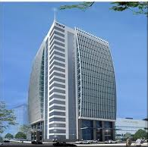
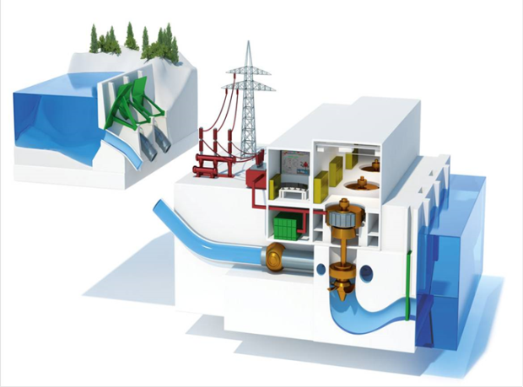
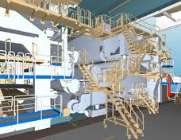
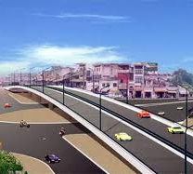
Business Field
Provide products, services and integrated solutions for:
Electric Factory
Building
Traffic system
Industrial buildings

Slide 6
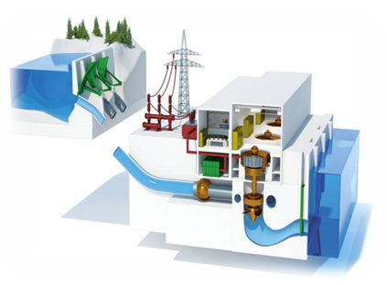
HYDROELECTRIC
Range of activities
Supply equipment:
Turbine and speed regulator;
Generator and Exciter
Valve input Turbine
Control and Protection;
Auxiliary mechanical system;
Auxiliary electrical system;
Station equipment
Service Provider:
Design;
Project management;
Shopping;
Construction manager;
Installation;
Experiment and start up the plant;
Operation, repair and maintenance training
Being the largest Vietnamese contractor providing mechanical and electrical equipment and technical services for hydropower plants

Slide 7

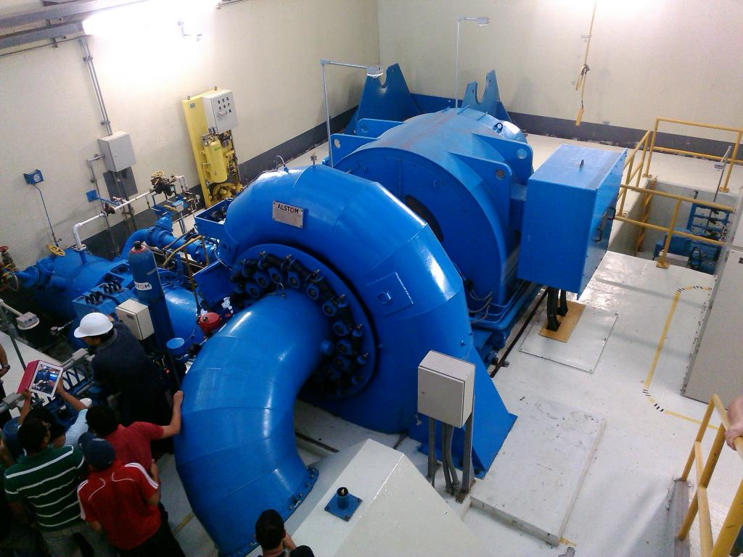
HYDROELECTRIC
Solution
Main equipment:
Experienced in cooperation with European companies and some well-known names in India and China;
Experience the connection and make the interface for the system ensure optimal operation
Control and Protection System
Use of core electronics and software licenses from European countries or G7;
Integrate and develop systems with technological know-how from experienced engineers and support from vendors;
Provide solutions tailored to the needs of each customer;

Slide 8
HYDROELECTRIC
Solution
Subsystems:
  Compact design for small hydropower and conventional design for large hydropower;
Evaluating, selecting qualified technical suppliers for the projects, developing the list of suppliers;
Providing technical services and after-sales service of quality.

Slide 9
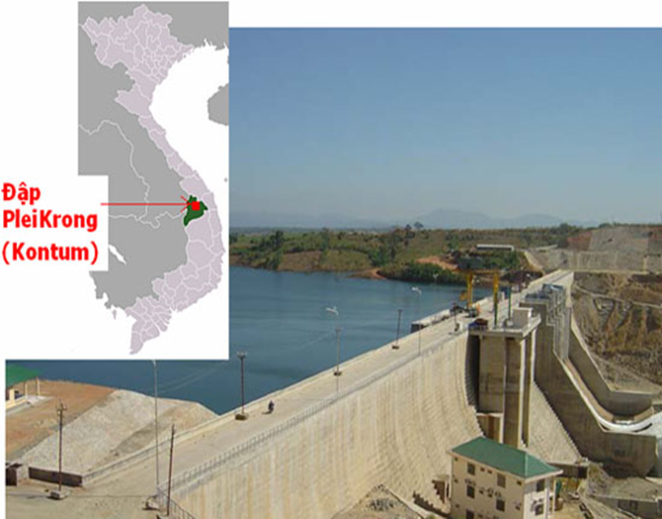
MONITORING
Operation
Solution:
Dams;
Underground work
Technical services:
Design, equipment supply, installation;
Operating the system, providing data;
Service, analysis and evaluation of works;

Slide 10
MONITORING
Products
Datalogger and Cable
Extensometers
Joint/
Crackmeter
Inclination
Load/Pressure
Monitoring
Software
Settlement
Readout
Strain
Temperature
Water
Tiltsensors

Slide 11
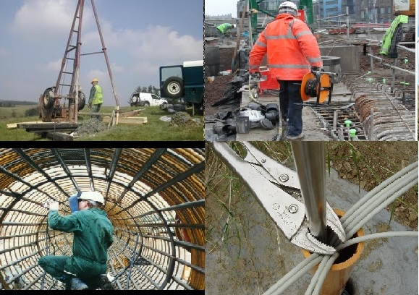
MONITORING
Engineering Services
Design
Purchasing
Manufacturing
Project management
Construction management
Installation
Test
Onsite Trainning
Technical after sales service

Slide 12
ACHIEVEMENT 1
2007 | Provide some auxiliary equipment for A Vuong Hydropower Project and Pleikrong Hydropower Plant
2008 | Provide some auxiliary equipment and technical services of Kanak Hydropower, Bac Ha Hydropower, Dakrik Hydropower, Nam Cong 3 Hydropower Plant.
2010 | Established Viettronics Industry JSC. The corporation assigned to implement the above projects.
2012 | Complete and put the above projects into operation Cooperate with a number of domestic and foreign partners, continue to develop by traditional industry and have achieved certain success.
2013 till now | Cooperate with a number of domestic and foreign partners, continue to develop by traditional industry and have achieved certain success.

